Slide 1

NNcompare An R package supporting the peer programming process in clinical studies
Mette Dahl Bendtsen, Novo Nordisk A/S Steffen Falgreen Larsen, Novo Nordisk A/S Frederik Vandvig Heinen, Novo Nordisk A/S Claus Dethlefsen, Novo Nordisk A/S

Slide 2
Disclaimer
Views and opinions expressed are those of the speaker and not necessarily Novo Nordisk
Notes:
Please note this disclaimer

Slide 3
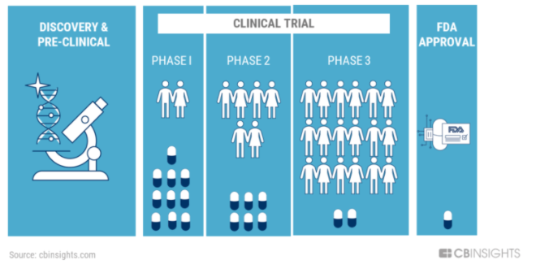
Background information
Clinical development process
Conduct
Reporting – including tables, figures and listings (TFL)
Submission to health authorities
Reporting clinical studies require a high level of quality
Programming
Performing and documenting reviews
The Future Of Clinical Trials: The Promise Of AI And The Role Of Big Tech (cbinsights.com)
Notes:
A little background information of why we need the functionality of this package.
To those of you who do not know, Novo Nordisk is a Danish pharmaceutical company developing pharmaceutical products – especially within Diabetes Care, but also in other areas as haemophilia and growth hormone disorders.
The clinical development process is long and consists of different phases
– the discovery and testing of new candidate drugs in the laboratory and in animal studies.
- the conduct clinical trial to investigate the effect and possible side effects in patients
- and finally submission of the results to the health authorities to get their approval of the new product.
Based on the data collected in clinical studies, a clinical study report is written presenting and interpreting the results.
For that purpose, a lot of tables, figures and listings (TFL) are developed.
To ensure a high level of quality, Novo Nordisk has defined procedures regarding programming and reviewing of the TFLs, and
Accordingly key results must be what we have here called ”peer programmed”.

Slide 4



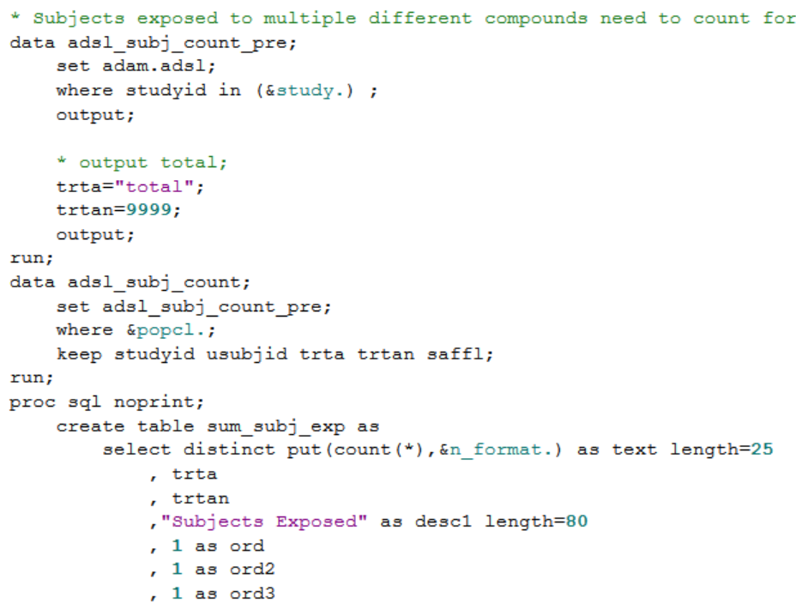
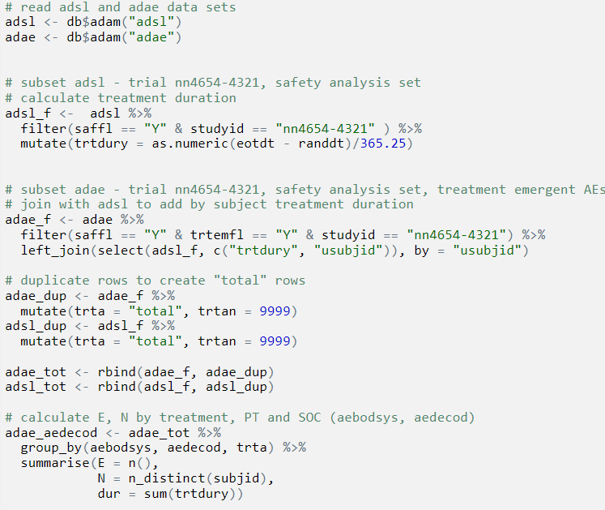
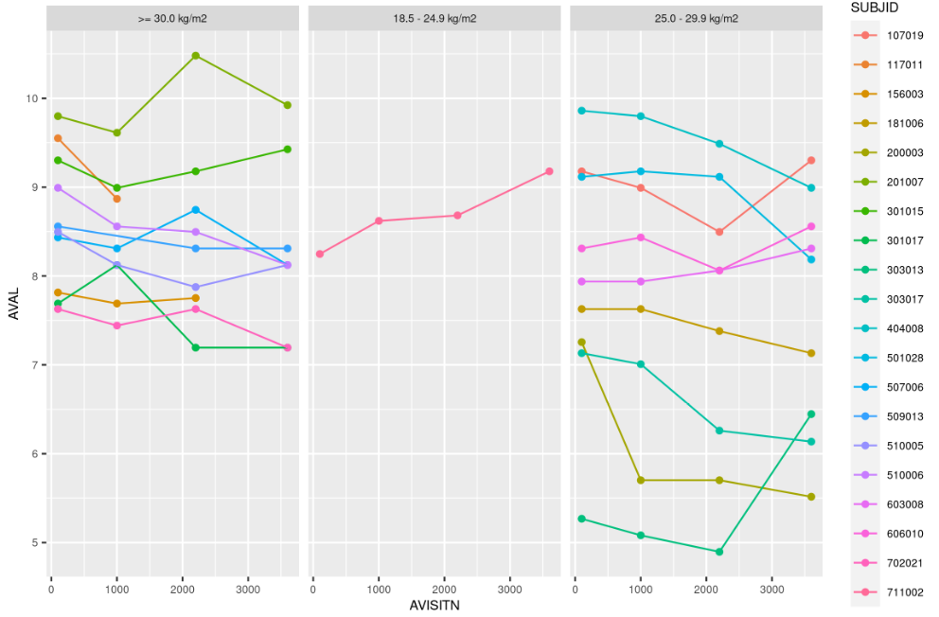
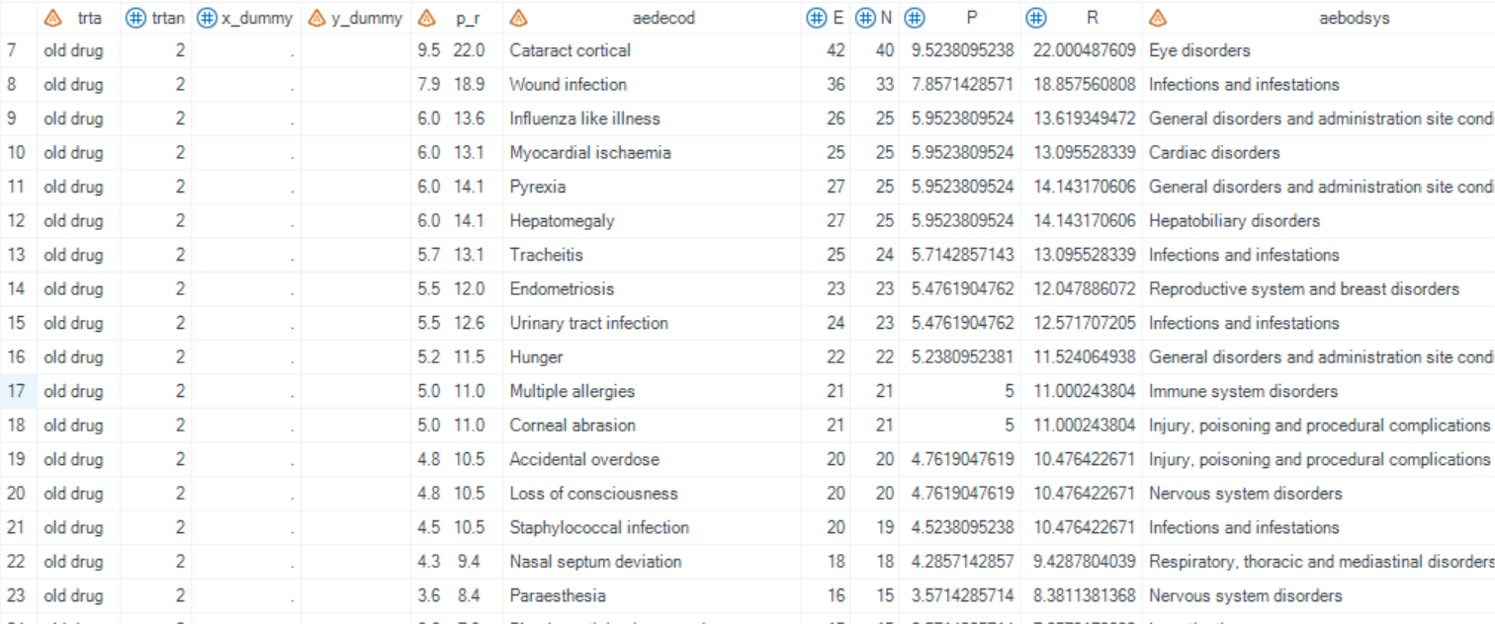
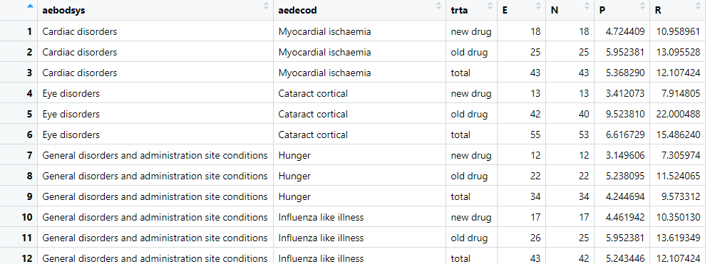
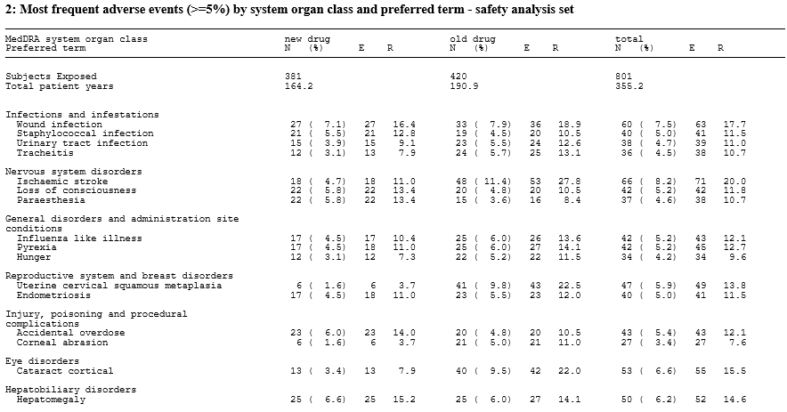

The peer programming process at Novo Nordisk
Programmer
Task
Reviewer
SAS / R
SAS / R
Compare the results
by e.g. using NNcompare
Notes:
The peer programming process at Novo Nordisk involves two persons: the programmer and the reviewer both working on the same ”task” – this could be a statistical analysis based on key data from a clinical study.
The programmer develops a program (most often in SAS, but it could also be in R). The program typically produces both a data frame with the results of the statistical anlayses and the tables or plots to be included in the clinical study report, presenting the results.
The reviewer creates a peer program that reviews / validates the programmer’s work.
To avoid being influenced by the programmer’s code, the reviewer should not read it until after preparation of the peer program.
The peer program typically produces a data frame that should then be compared with the data frame from the primary program,
and for that you can use the Nncompare package.

Slide 5
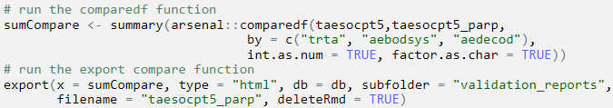

NNcompare functionality
NNcompare
html
docx
pdf
Report with results of comparison
Summary report of multiple comparisons
Notes:
The actual comparison of the two data frames is done with the compared() function from the arsenal package.
The two data frames do not have to be sorted in the same order if you, as here, specify the key variables in the by argument.
The export function is called on the summary object of the comparison, which creates a report with the results of the comparison.
The report can be in various formats, and furthermore a summary report is created summarising all comparisons made within a given study.

Slide 6
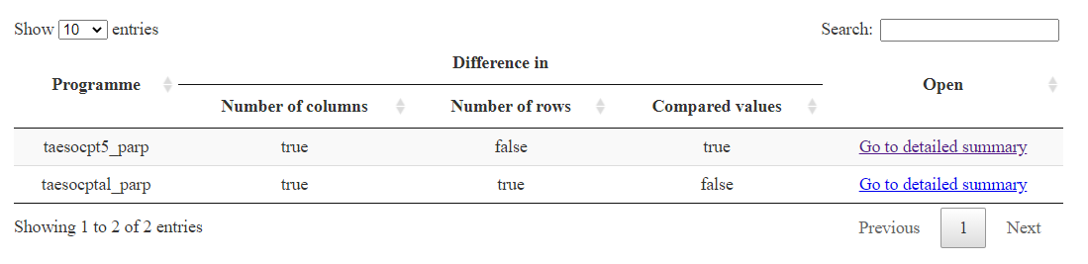
Results of comparisons - summary
Notes:
The summary report shows whether differences are detected in either number of columns or rows, or in any of the compared values.
Furthermore, it contains links to the detailed summary reports.

Slide 7
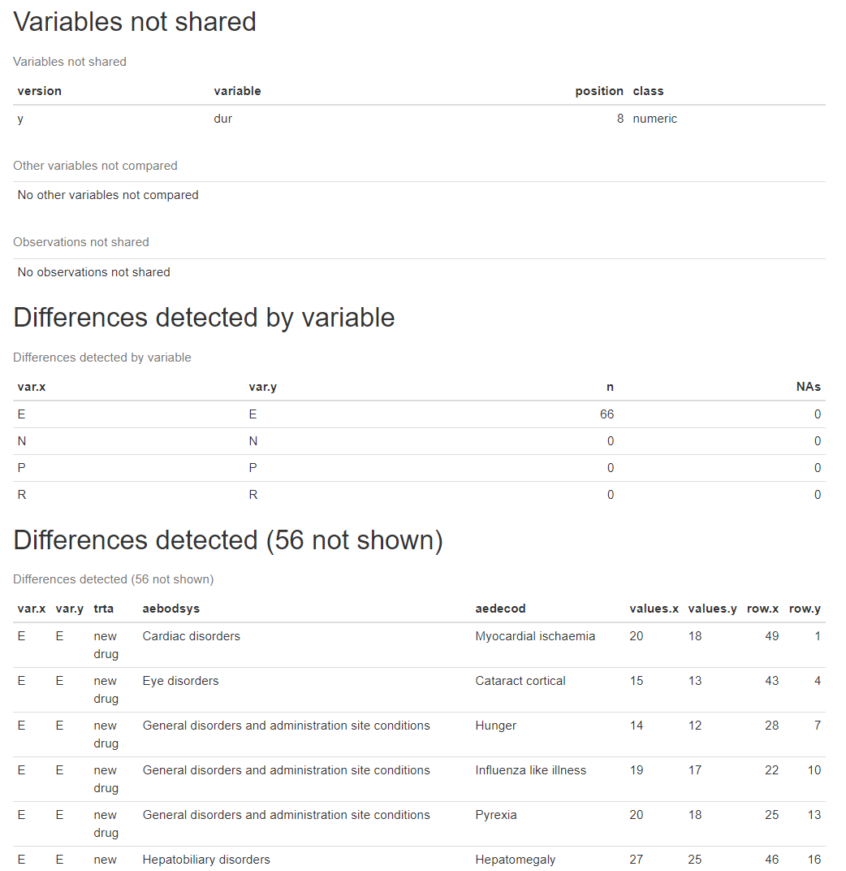
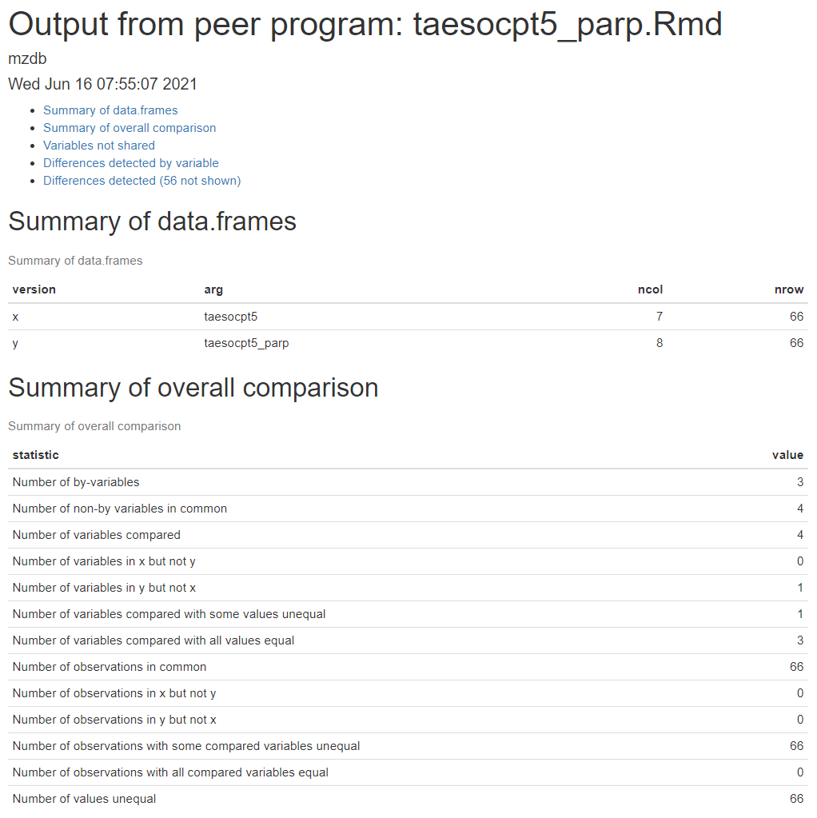
Results of comparisons
Notes:
This is an example of the detailed report with the results of a comparison.
Here you can see that there is a difference in the number of columns in the two data frames.
Furthermore it shows that different values are detected in the E variable, and some details about the differences are shown.

Slide 8
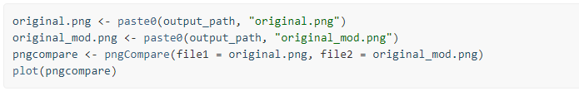
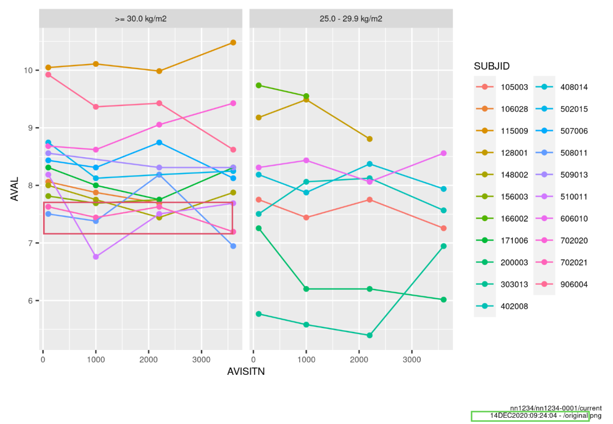
Comparing png files with pngCompare()
Compare png files
Pixel-wise comparisons
Mark changes
Time stamp in footnote
Notes:
The Nncompare package also makes it possible to compare PNG files with the pngCompare function.
This is used to discover changes in plots that for instance can happen during finalisation of the data sets between presenting the results to management and writing the clinical study report.
Two PNG files are compared pixel-by-pixel and any changes are marked with a red box as depicted on this slide.
Time stamp changes are OK and are marked with a green box.

Slide 9

Further development...
Additional functionality
comparing multiple datasets with one function call
overview of results of multiple png files comparisons
comparing other file types
...
NNcompare package available at github: NNpackages/NNcompare (github.com)
Notes:
We have some ideas for further development of the package
- it could be useful to be able to compare more than one pair of data sets in a single call
- furthermore we would like to implement an overview of results of several png file comparisons
- and finally we could consider to implement functionality to be able to compare other file types.

